Slide 1

Welcome to:
Maker Training Session
5:30 PM Tuesday, January 30, 2018
Broun Hall, Room 123

Slide 2

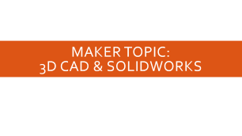




Agenda

Slide 3
About SPARC

Slide 4
Introduction
Student lead organization at Auburn University.
Creates and fosters an environment of creativity and innovation through collaborative projects.
A place to test out ideas, integrate concepts learned in class, and learn skills that will be instrumental when working in the workforce.
No prior experience is required, only a willingness to learn.
Great for students of all ages and majors.

Slide 5


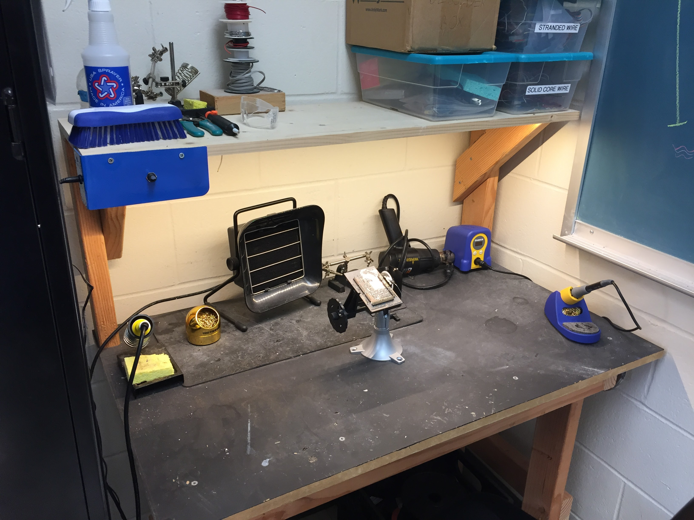
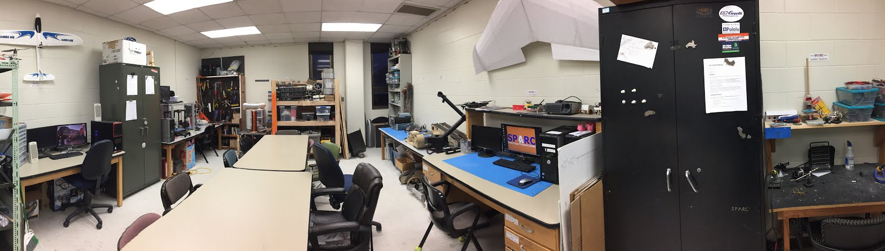
Our Lab
Broun Hall
Room 367

Slide 6
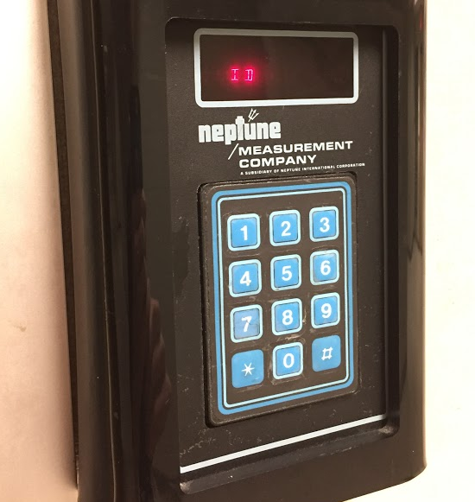
How to become a Member
Log 5 constructive hours in the lab
Write the times on the sheet on the clipboard next to the door.
Contact us at sparc.auburn@gmail.com
We will respond with the instructions to get an access code.

Slide 7
SPARC Meetings
Open Forum
Discuss status of active projects
Learn about and discuss specific topic in the realms of technology, engineering or making.
Wednesdays at 6:00 PM
Maker Training Session
Learn about a specific skills like 3D printing, CAD, electrical prototyping, and robotics.
Centered around SPARC Sumo Bot Competition
Tuesdays at 5:30 PM
Project Meetings
Project members come together to talk about detailed progress.
Meeting times and locations vary from project to project.

Slide 8



Partner Organizations
NASA Robotics Mining Competition Team
President: Jeremy Frasher <jjf0010@auburn.edu>
Meets on Mondays 6-7, SPARC Lab, Broun 367
RC Hobbyist Club
President: Craig Legrand <cbl0019@auburn.edu>
Meets on Mondays 3:30-4:30, SPARC Lab
Fridays 3:30-5:00, Broun 235
IEEE Auburn University Student Branch
President: Michelle Kniffen <mek0027@auburn.edu>
Meets on announced Mondays, Broun 238

Slide 9




More Information about SPARC
Website
http://sparc-auburn.github.io/
Github
https://github.com/SPARC-Auburn
Slack
https://sparc-auburn.slack.com/
Email
sparc.auburn@gmail.com

Slide 10
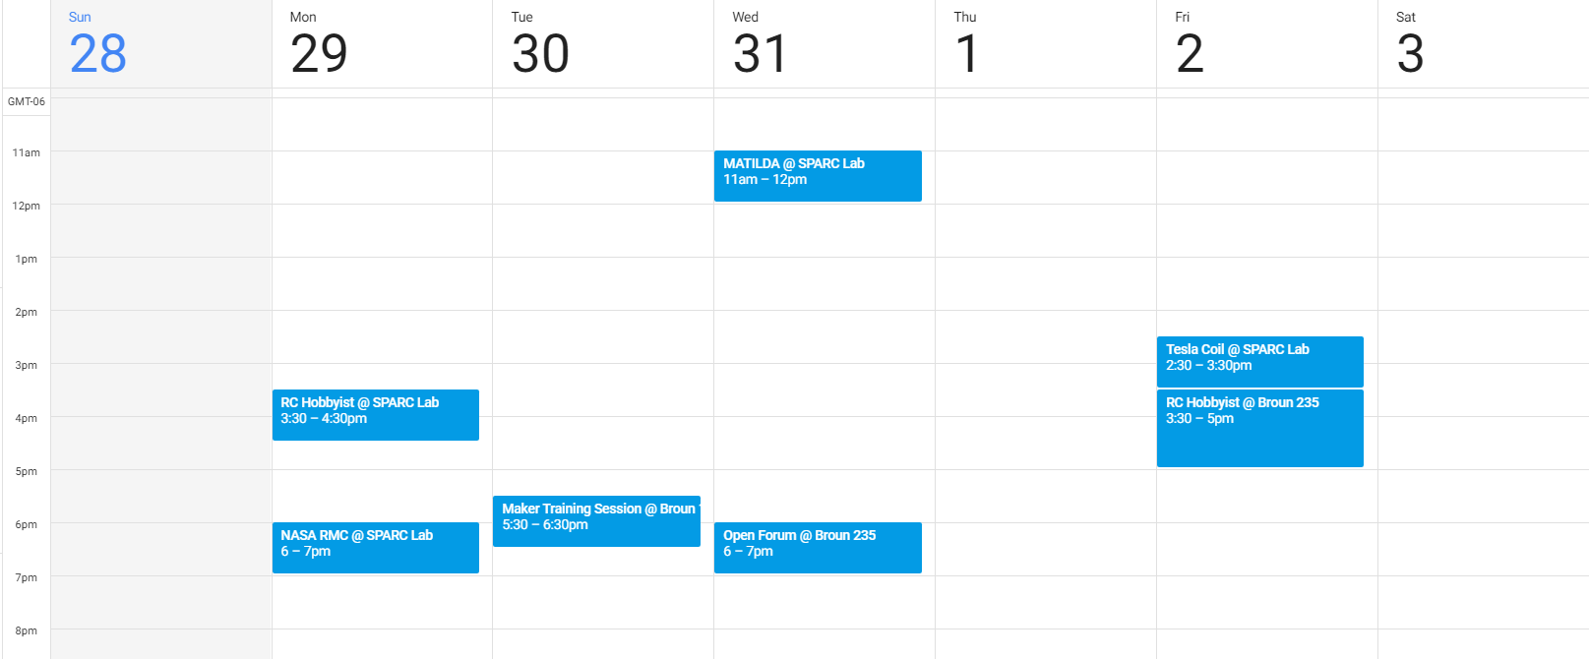
Meetings this Week

Slide 11
Outreach

Slide 12
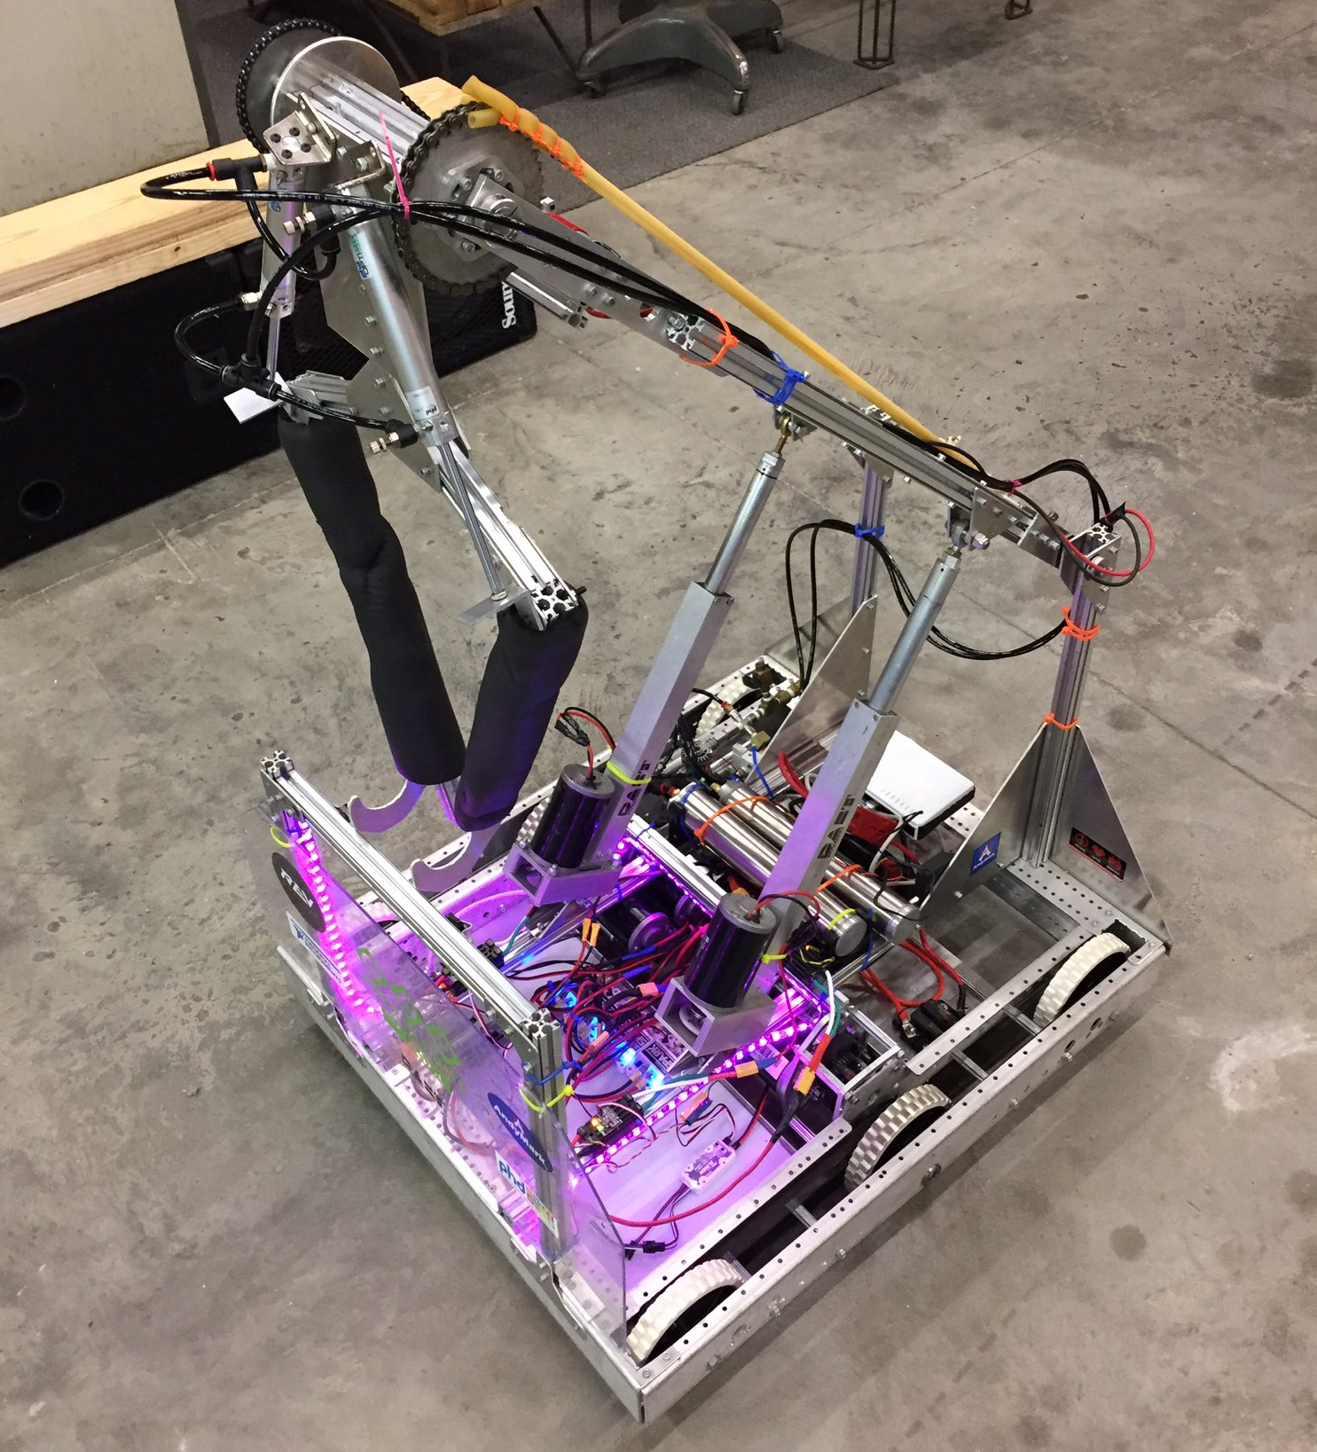
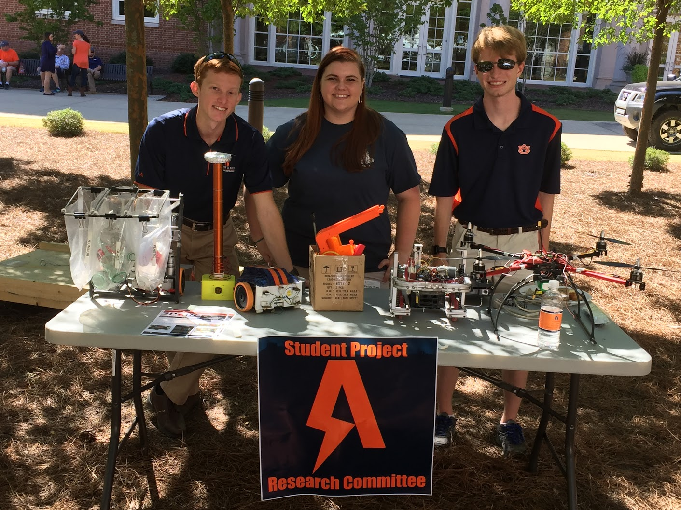
Outreach Events
Opelika HS FRC Team
Help mentor a FIRST Robotics Competition (FRC) Team
Mon Tue Thu: 3:30-6:30, Fri: 3:30-9:30, Sat:10-6
E-Day
Help display projects in Broun, Student Center, and Concourse to high school students.
Friday, February 23rd
Robot in 3 Days 2018 Bot
Engineering Tailgate 2016 SPARC Table
Notes:
Fall 2016
Loachapoka Robotics Mentoring- Mondays, Tuesdays, and Thursdays 3:00PM to 4:30PM
ECE Minority Presentation- November 14th
AJHS E-Day- November 17th
South’s Best- December 3-4th
SCORE Claw Machine- December 3-4th
Spring 2016
E-Day- Late February or early March
SPACE Day- Possible Event Next Semester
IEEE Sumo Robotics Competition (with local middle and high schools)- Spring 2017

Slide 13
Projects

Slide 14
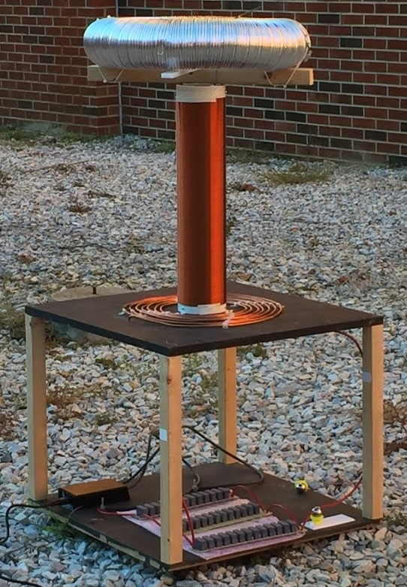
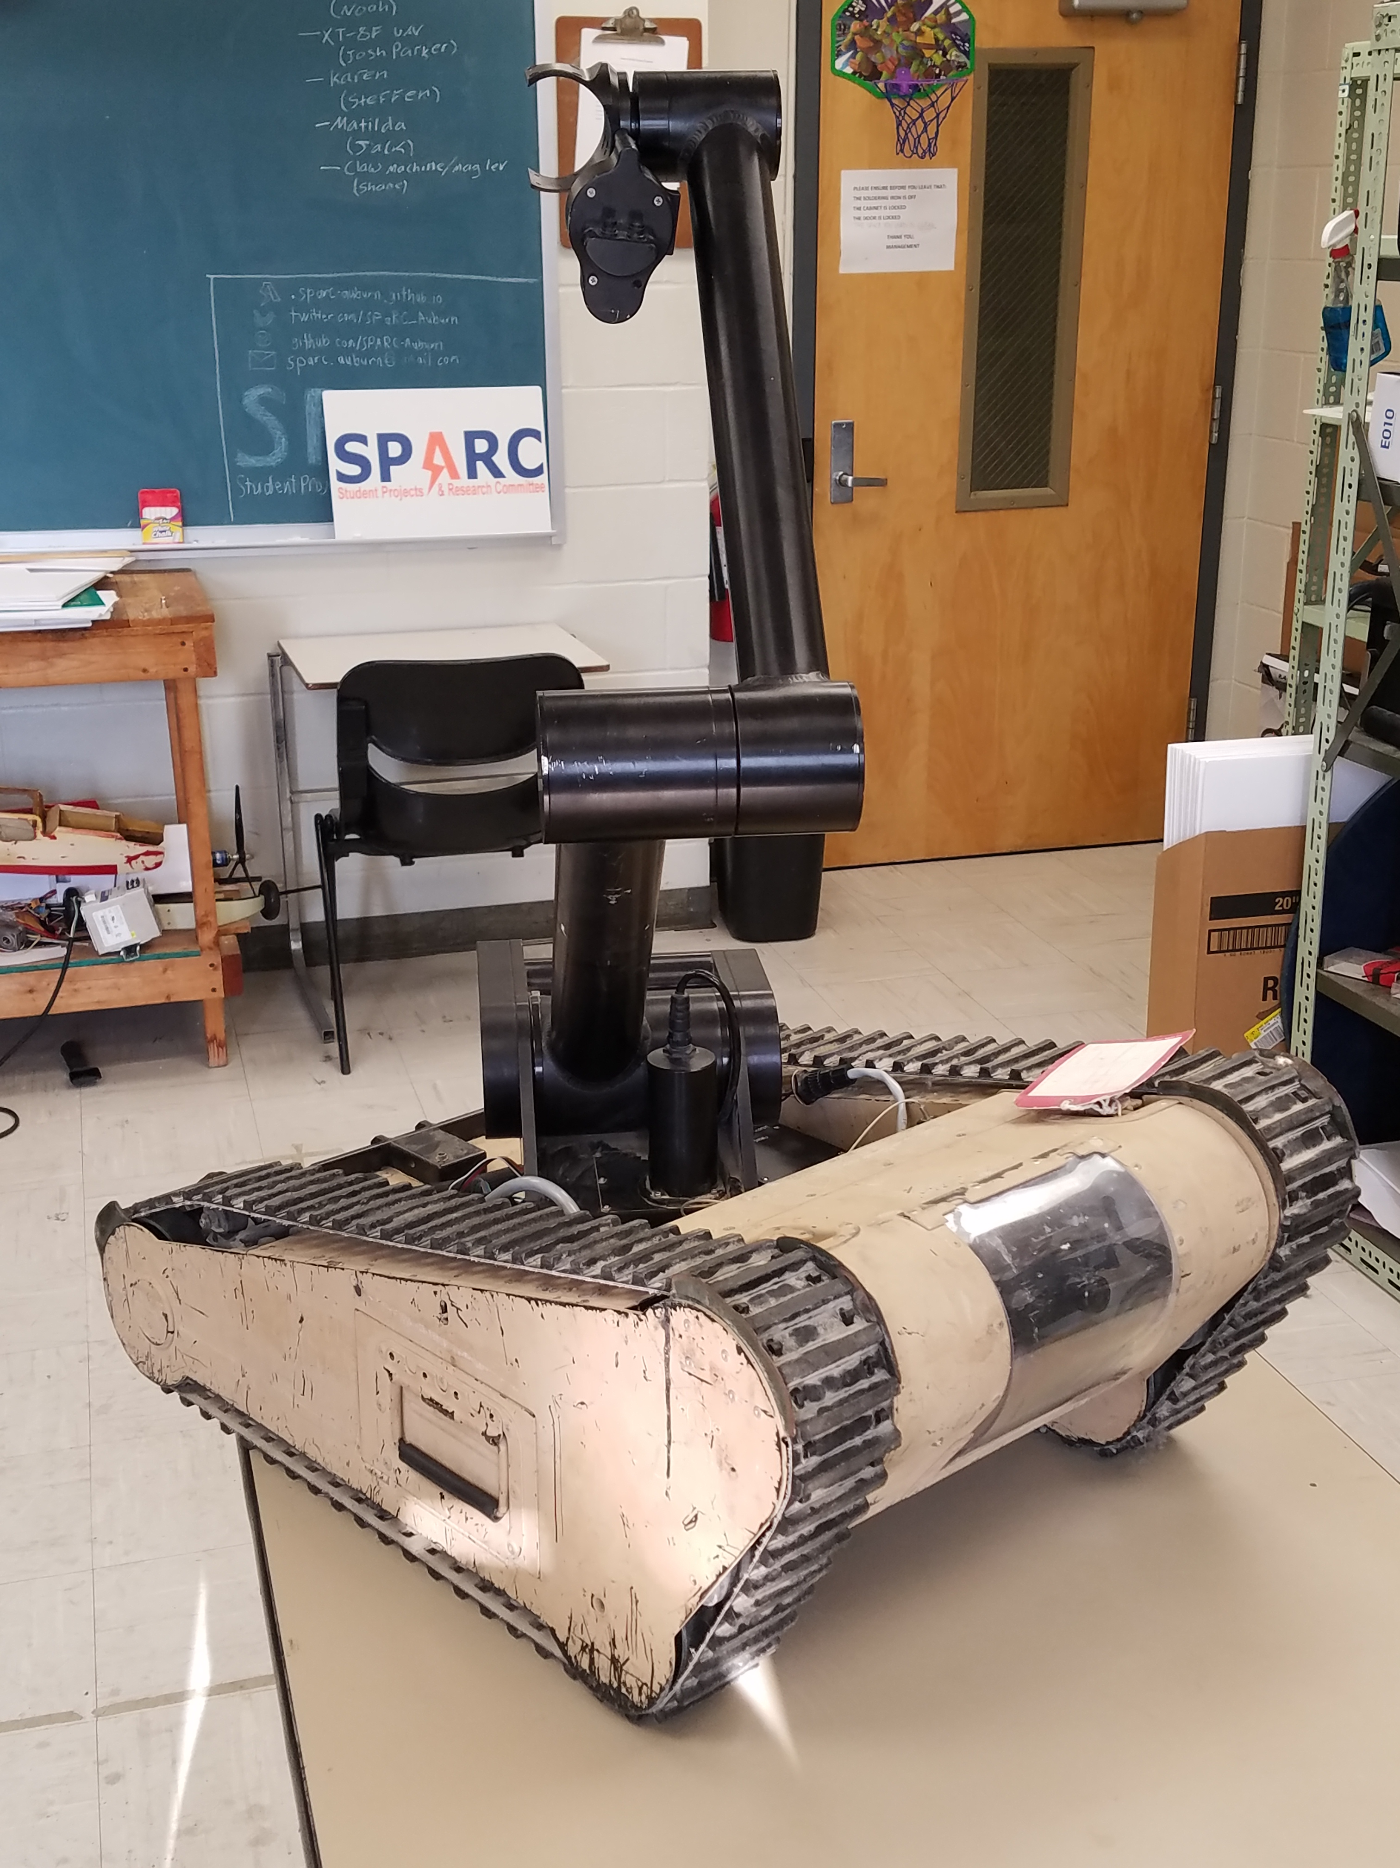
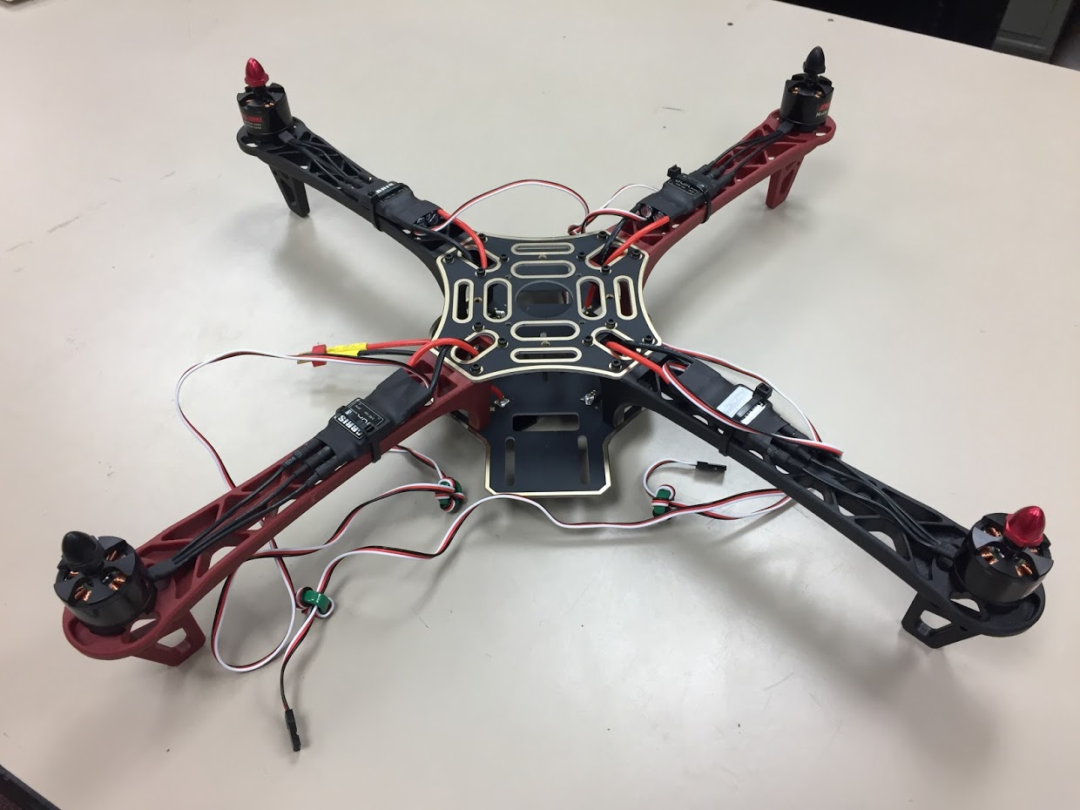
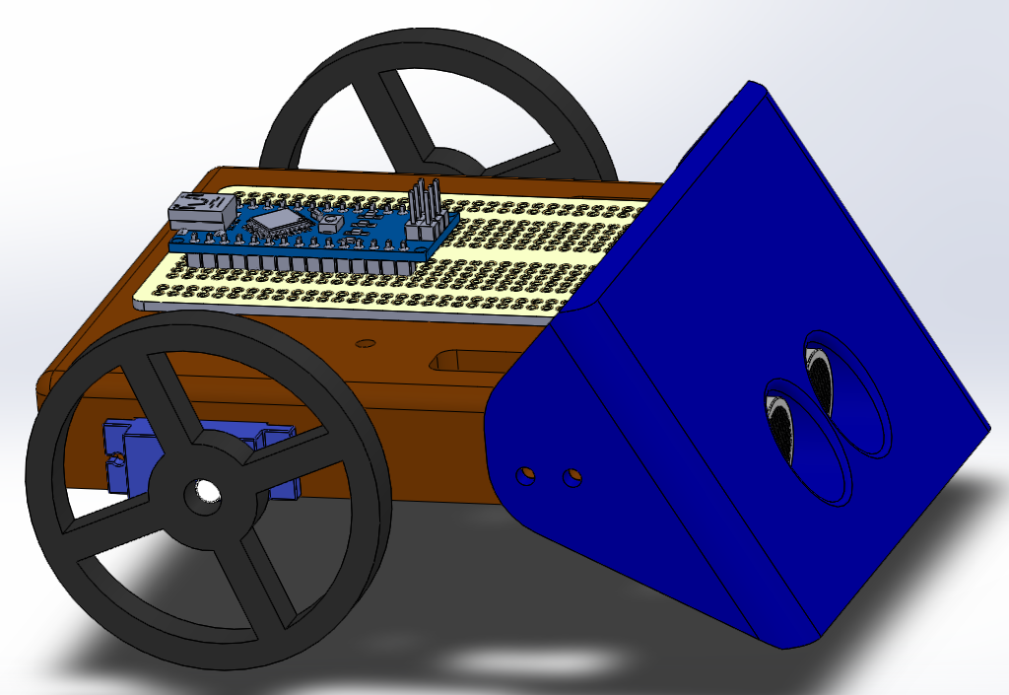
Spring 2018 Main Projects
MATILDA Robotics Platform
Tesla Coil
Unmanned Aerial Systems
Sumo Bot Competition

Slide 15
Sumo Robotics Tournament

Slide 16
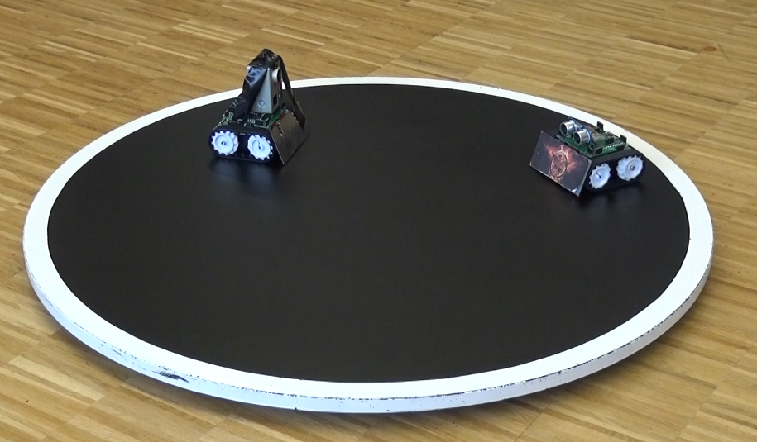

What is a Sumo Bot Competition?
Two robots are placed in a ring
Goal: attempt to push each other outside of ring.
Typically autonomous
First robot that touches outside of the ring loses the round.
The competitions “are non-destructive, family friendly, and great learning experiences.”
Classes of Sumo Bots
Japanese class (< 6.6 pounds)
Mini-class (< 1.1 pounds)
More information: http://www.robotroom.com/SumoRules.html
https://mcuoneclipse.com/2014/12/21/sumo-with-gopro-and-other-sumo-videos/
Mini Class
Japanese Class

Slide 17
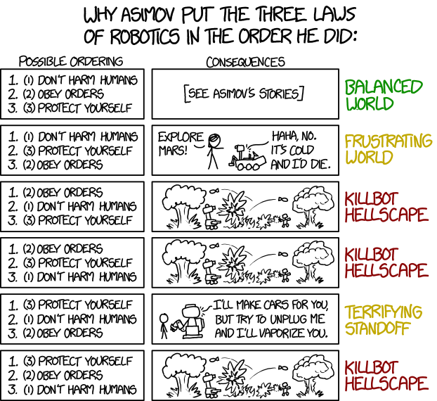

SPARC Sumo-Bot Requirements
Weight Constraint: < 750g(1.65lbs)
Size Constraints (at start of round)
Width: 15cm (5.91”)
Length: 15cm (5.91”)
Height: $∞$
Robots must not
Emit smoke or fire
Leak, stain, or soil
Disperse powder, grit, or grime
Spray, throw, or use projectiles
Jam, shock, or electromagnetically interfere
Snare, entangle, or employ nets/rope
Scratch, gouge, or scrape
Have sticky/magnetic/suction wheels
XKCD: https://xkcd.com/1613/

Slide 18
SPARC MINI-CLASS Part Requirements
up to 3 micro continuous servos
up to 2 servo wheels
all mechanical frame must be 3D printed
no sheet metal or raw plastics allowed
use any screws, nuts, washers
use Arduino Nano (clones), protoboard, wires, etc.
up to 2 Ultrasonic sensors
up to 4 line following sensors

Slide 19
Maker Training Sessions

Slide 20
Maker Training Session Topics
Version Control (Git and GitHub)
3D CAD Parts (Solidworks)
3D Printing (Lulzbot Taz 3 w/ Cura)
3D CAD Review and Assemblies (Solidworks)
Electrical Prototyping and intro to Arduino
Soldering and Electrical Fabrication
Basic Robotics Programming and PWM
Basic Sensor Programming

Slide 21
Maker Topic: 3D CAD & SolidWorks

Slide 22
Why use 3D Computer Aided Design
A fast and accurate way of drawing parts and assemblies
Provides more detail than a whiteboard sketch
Visualize how objects fit together
Helps determine potential issues in design rather than manufacturing
Allows rapid development

Slide 23

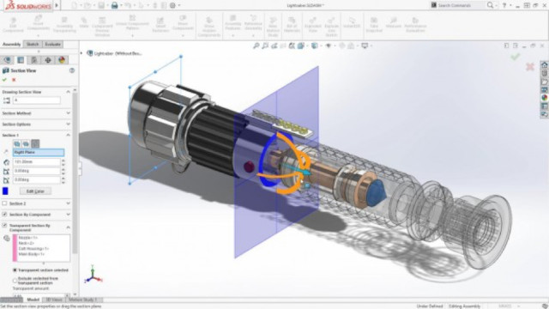
Why Use
A powerful 3D CAD software suite developed by Dassault Systems.
Is used by many companies around the world.
Has a good balance of intuitive controls and precision tools.
Has an extensive collection of useful analysis tools.
Is free for Auburn University students.

Slide 24





Alternatives to SolidWorks

Slide 25
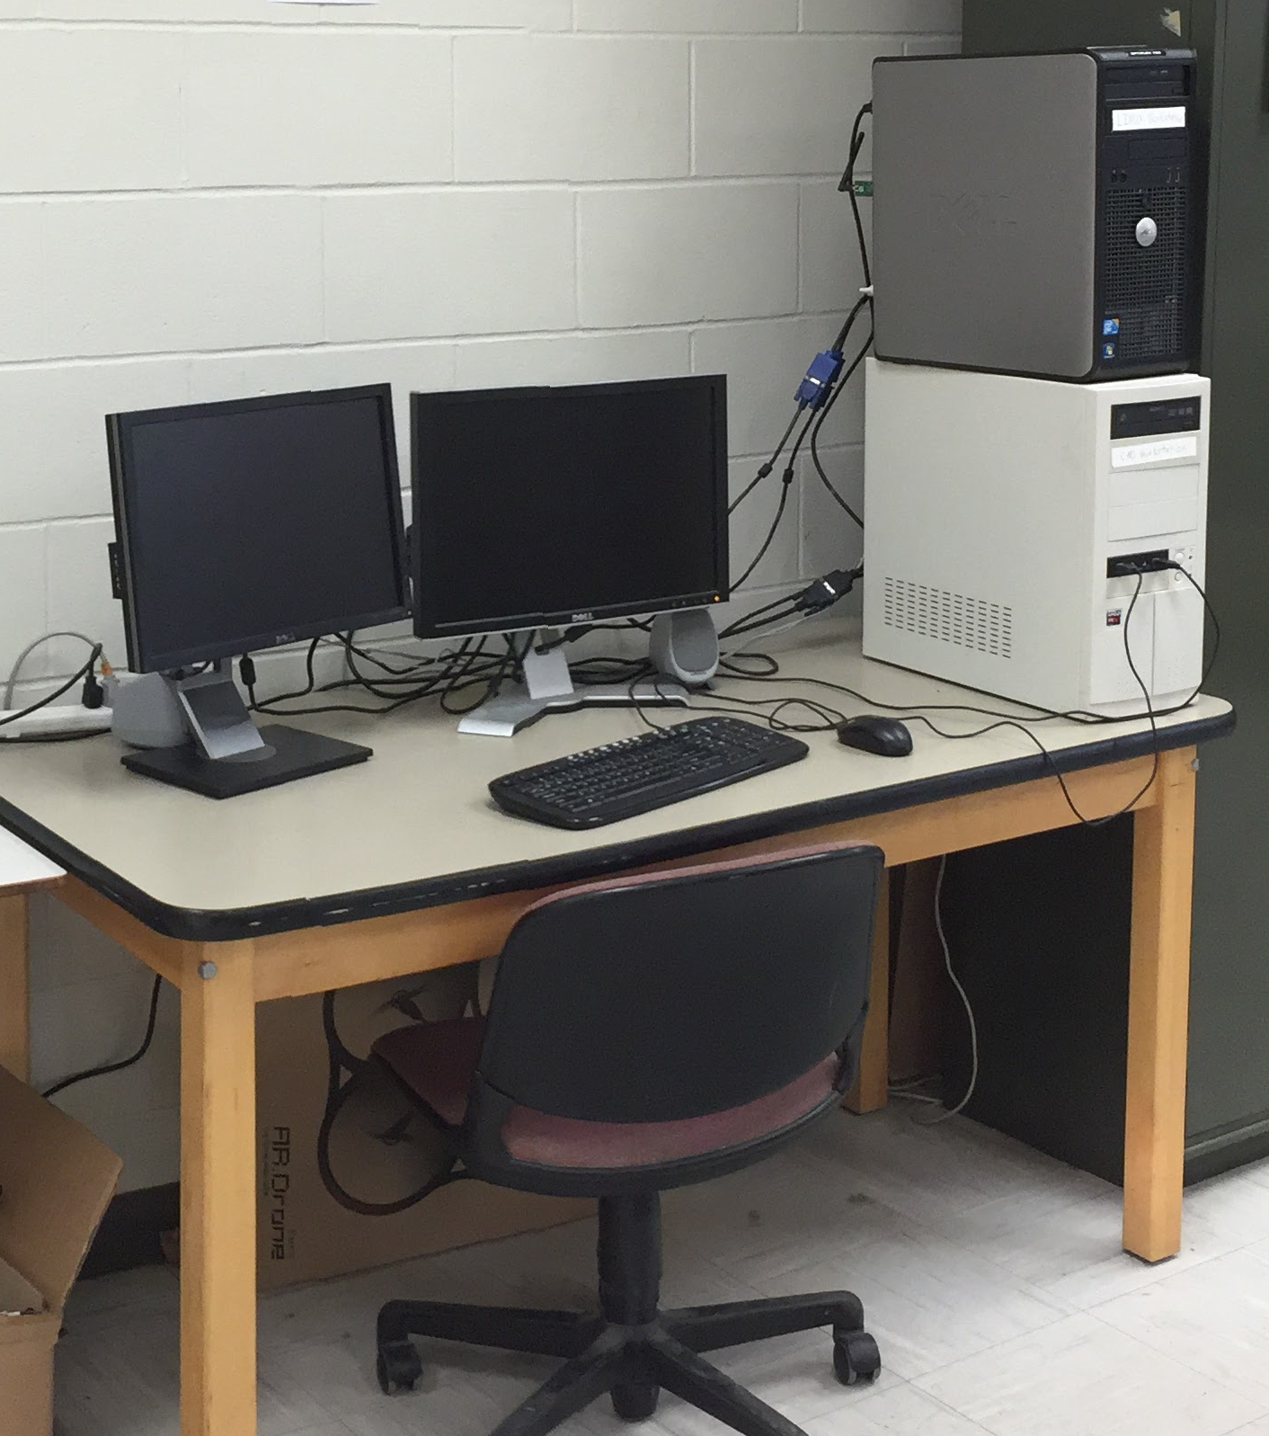
How to Access SolidWorks
Use the SPARC CAD Workstation
Use an Engineering Network Services Computer Lab
Broun 123
Shelby 1202,2119,2122,2210
Davis 123,330
Ross 306,370
Download the student version
https://imapssl.eng.auburn.edu/software/software/showcase.php?software=solidworks

Slide 26
Minimum Computer Requirements
Windows 7, 8.1, 10 64-bit
Macbook users must use Windows in Boot Camp or virtual machine
8GB or RAM or higher is recommended
Must have physical mouse with center wheel
Laptop touchpads do not work well
At least 8GB of Storage space
Performance will increase with better graphics cards.

Slide 27
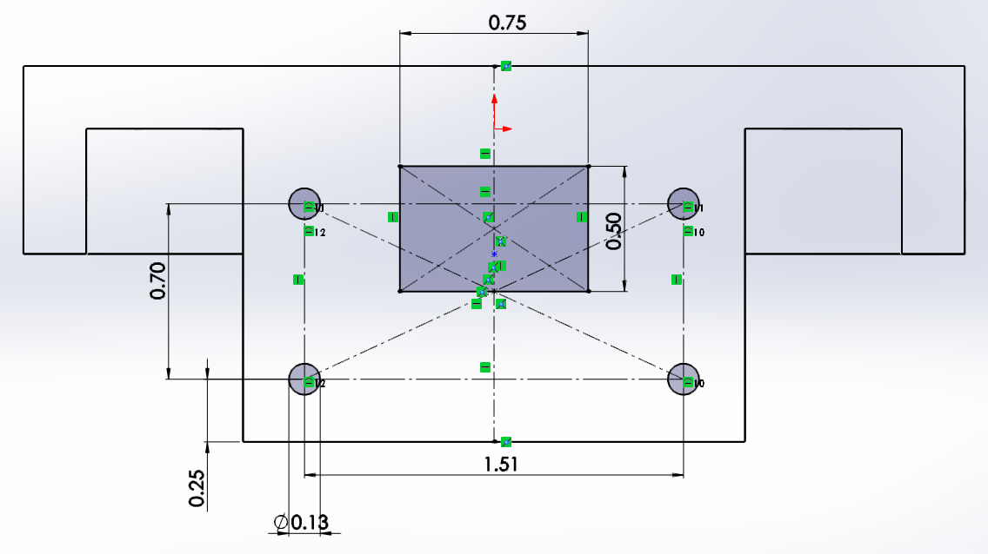
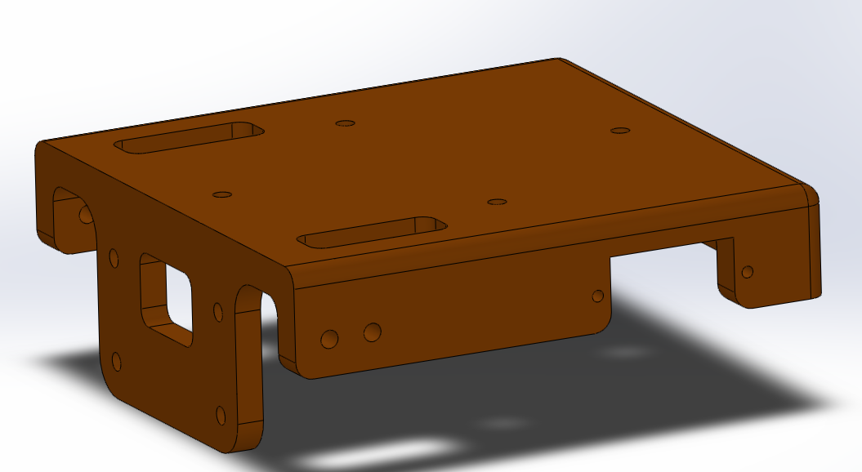
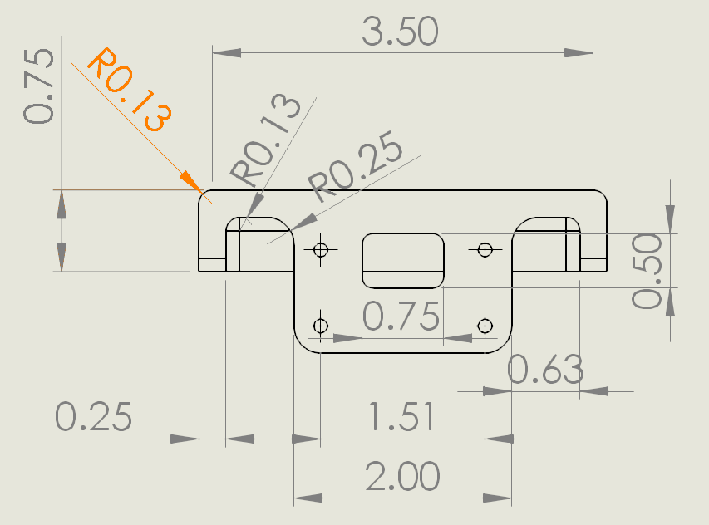
Aspects of 3D CAD
Sketches: usually 2D drawing of a particular aspect of a part
Assemblies: A collection of connected parts
Parts: A single piece of an object
Drawings: A 2D representation of parts and assemblies.

Slide 28
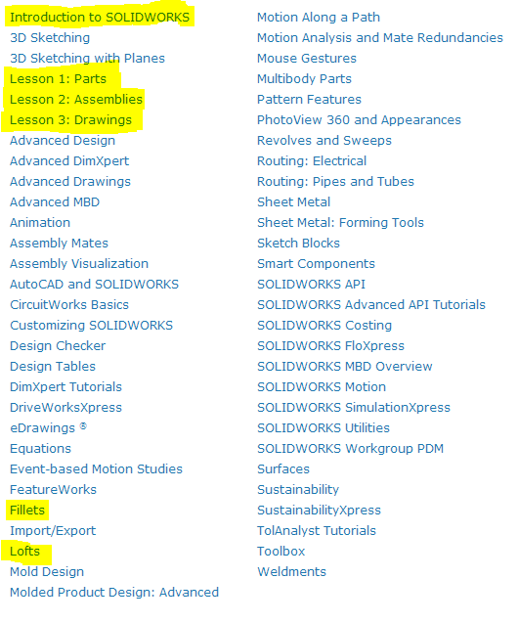
Learning SolidWorks
Free interactive tutorials are built into the software.
Ranges from basic skills to advanced topics.
Highlighted tutorials are best for beginners.
HELP > SOLIDWORKS Tutorials > All Tutorials

